Slide 1

Enhancing Sleep Stage Classification with Vision Transformers: A Study on Image Transformations, Data Augmentation, and Model Optimization
By
Janith Ramanayake
Supervisor: Dr. G.A.C.N. Priyadarshani

Slide 2

Contents
01
Background
02
Research Gap
03
Objectives
04
Methodology & Results
05
Final Model
06
Conclusion
07
Limitation
08
Further Works
Page
02

Slide 3

Background

Slide 4


What are Sleep Stages?
Sleep stages are the different phases of sleep that the brain goes through during a sleep cycle. They repeat in a cycle throughout the night, helping the body and mind rest, recover, and process information.
According to the Rechtschaffen and Kales (R&K) method, sleep can be classified into five stages that occur in a sleep cycle.
Stage 1 (Drowsy)
Non REM
Stage 2 (Light Sleep)
Stage 3 (Moderate Sleep)
Stage 4 (Deep Sleep)
REM
REM (Rapid Eye Movement)
Page
04

Slide 5

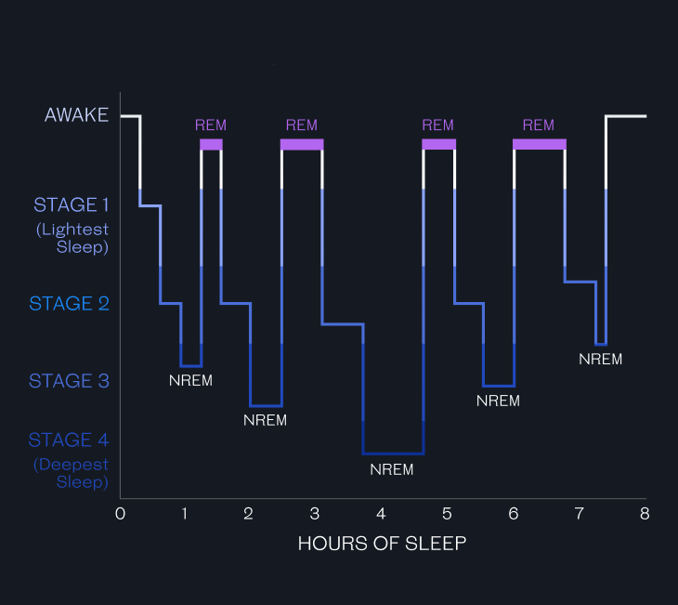
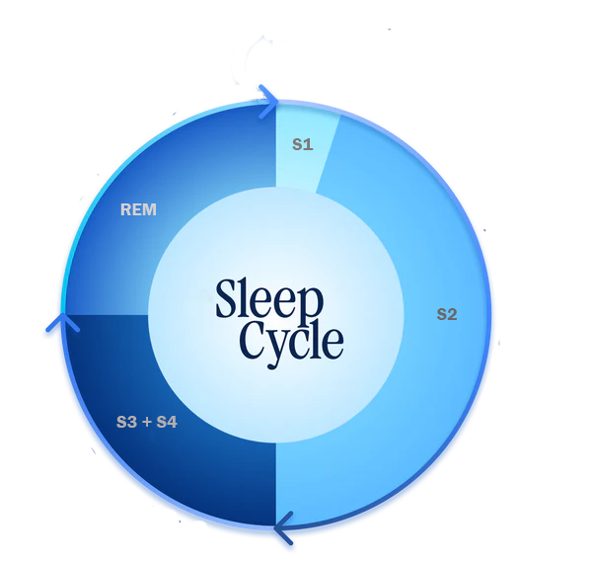
Sleep Cycles
A sleep cycle is a complete progression through the different stages of sleep, including Non-Rapid Eye Movement (NREM) sleep and Rapid Eye Movement (REM) sleep. Each cycle typically lasts about 90 minutes and repeats 4-6 times throughout the night.
In a sleep cycle, the duration of each sleep stage varies. By examining the total time spent in each stage throughout the night, we can evaluate sleep quality, identify abnormalities, and measure overall sleep efficiency.
Page
05

Slide 6

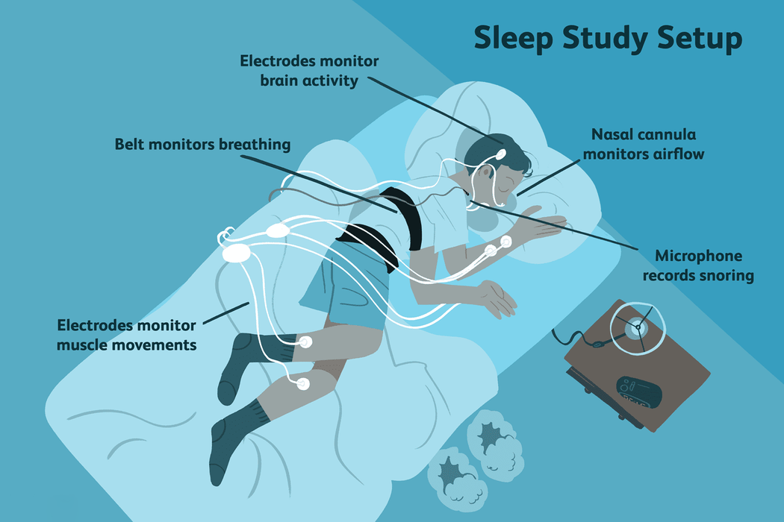
How To Classify Sleep Stages?
Polysomnography (PSG) is used for sleep stage classification because it provides detailed measurements of physiological signals during sleep, which are crucial for accurately identifying different sleep stages.
These PSG signals are typically gathered in sleep labs using overnight sleep study setups in a controlled environment. The signals recorded in PSG include:
EEG
Measures brain wave activity
ECG
Monitors heart rate and rhythm
EOG
Tracks eye movements
EMG
Measures muscle activity
Manually classifying sleep stages is slow, subjective, and prone to errors. Therefore, machine learning techniques are used for a faster and more reliable approach
Page
06

Slide 7
Research
Gap

Slide 8


Research Gap
Most studies train Transformers from scratch, demanding large datasets and high computation. The potential of pre-trained ViTs for PSG sleep classification, with better generalization and efficiency, remains underexplored.
Limited Use of Pre-Trained Vision Transformers
While various studies have explored transforming PSG signals into image representations, there is no consensus on the most effective method for Transformer-based models. A systematic comparison of these techniques, particularly in the context of ViTs, is needed to optimize feature extraction and model performance.
Underexplored Comparisons of Image Representation Techniques
The use of GANs for generating synthetic data in time series-to-image transformed data is rarely explored. Investigating its impact on ViT models could help address class imbalance and improve performance in low-data scenarios.
Limited Use of GAN-Based Data Augmentation
Page
08

Slide 9
Objectives

Slide 10

Research Objectives
Primary Objective
Develop an accurate Vision Trans formers (ViTs) based model for automatic sleep stage classification using Polysomnog raphy (PSG) data.
Secondary Objectives
Investigate different image transformation techniques for PSG signals.
Identify the most effective frequency representations for PSG-based image transformations.
Explore GAN-based data augmentation methods to improve model performance.
Page
10

Slide 11
Methodology

Slide 12
Methodology Overview
Signal Pre Processing
Time Series to Image Transformations
Data Augmentation
Best Image Transformation Method
GAF
MTF
Train Generalized DCGAN
Channel Selection
Spectrogram
Best Sampling Frequency
64 Hz
128 Hz
Fine-Tune For Each Sleep Stage
Low-Pass Filtering
256 Hz
512 Hz
Best Sampling Method
FFT
DWT
Generate Synthetic Images
High-Pass Filtering
Final Model Selection
Notch Filtering
Train From Scratch
Pre Trained
Page
12

Slide 13
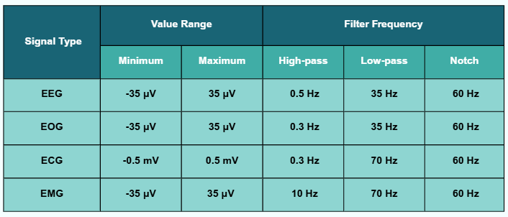
Channel Selection
There are over 50 different signal channels in the dataset. Based on literature, we selected the following 15 channels, as they have been proven to be more effective for sleep stage classification.
EOG
EEG
F7 - T3
T3 - T5
Fp1 - F3
F3 - C3
C3 - P3
P3 - O1
ECG
Fp2 - F4
F4 - C4
C4 - P4
P4 - O2
EMG
F8 - T4
T4 - T6
Signal Filtering
Raw PSG signals often contain noise from various sources. To improve quality, we applied filters to preserve relevant information.
Signal specifications and filtering parameters
Page
13

Slide 14



Image Transformation Methods
Converting time-series data into images is the core of this research. This enables the use of image-based techniques for sleep stage classification. We apply four different methods to perform this conversion effectively.
Time Series Data
normalize to
convert to
[-1,1] range
angular space
Discretize to Q equal size bins
Map values to [0, 255]
&
Apply Color-map
Spectrogram Image
Map values to [0, 255] & Apply Color-map
GASF Image
GADF Image
MTF Image
Page
14

Slide 15

Experiment 1
Best Image Transformation Method
F7 - T3
T3 - T5
Fp1 - F3
F3 - C3
1
The selected 15 channels, along with their average channel, are segmented into 30-second epochs
C3 - P3
P3 - O1
Fp2 - F4
F4 - C4
2
Each channel within an epoch was transformed into an image using the designated method and resized to 224×224 .
3
The resulting images were concatenated into a 4×4 matrix, creating a single image representation per epoch, as illustrated.
C4 - P4
P4 - O2
F8 - T4
T4 - T6
4
A total of 12,000 images with 2,000 images per sleep stage were selected randomly.
EOG
EMG
ECG
Avg
5
The pre-trained ViT B/16 model was then used to ensure a fair comparison across different transformation techniques.
16 PSG channels to form a unified image representation
Page
15

Slide 16

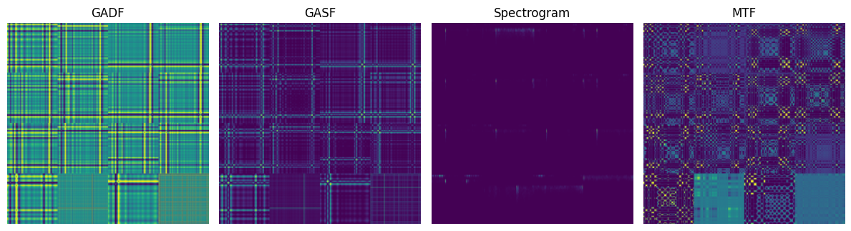
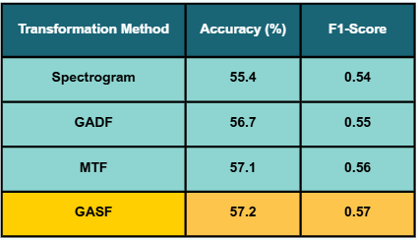

Experiment 1
Results
Visual representation of different image transformation techniques applied on same epoch.
According to accuracy and F1-score, GASF provides the best classification performance. Also it gives best structured feature representation according to DBI and CHI.
GASF is the Best Method !!
Page
16

Slide 17




Downsampling Methods
Downsampling signals reduces computational complexity and storage needs while preserving essential information. It removes redundant data and optimizes processing. In this study, we use two downsampling methods.
Time Series Data with sampling frequency fs
Apply
Remove frequencies above Nyquist frequency
Fast Fourier Transform
Apply
Inverse FFT
Apply DWT
With Daubechies wavelet
Remove frequencies above Nyquist frequency
Perform decimation by keeping every fs / fnew samples
Apply DWT on A[n]
(fs / fnew )-1 times
DWT Downsampled Data
FFT Downsampled Data
Page
17

Slide 18
Experiment 2
Best Sampling Frequency & Method
1
The selected 15 channels, along with their average channel, are segmented into 30-second epochs
2
Each channel within an epoch was downsampled using the designated frequency and method.
3
Generate images for each epoch using the GASF method.
4
A total of 12,000 images with 2,000 images per sleep stage were selected randomly.
5
The pre-trained ViT B/16 model was then used to ensure a fair comparison across different sampling frequencies and methods.
Page
18

Slide 19
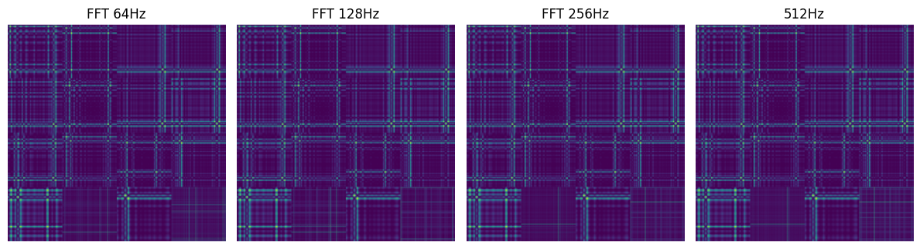
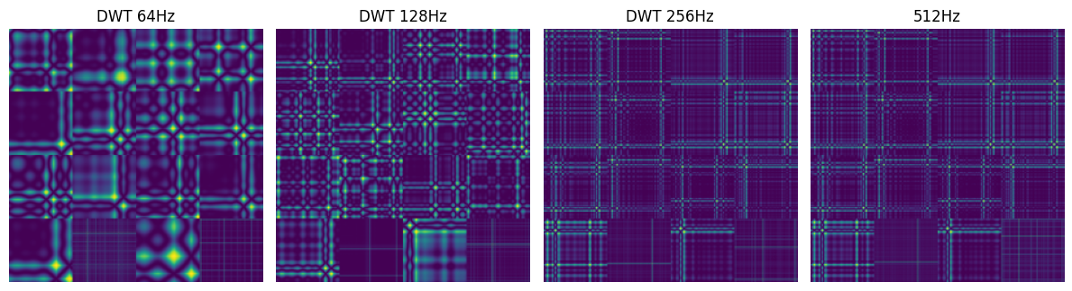
Experiment 2
Results
Visual representation of different sampling frequencies and methods applied on same epoch.
Page
19

Slide 20
Experiment 2
Results...
Resampling Method | Sampling Frequency | Accuracy (%) | F1-Score
Original | 512 Hz | 57.2 | 0.57
FFT | 256 Hz | 58.0 | 0.57
FFT | 128 Hz | 56.3 | 0.55
FFT | 64 Hz | 53.8 | 0.52
DWT | 256 Hz | 58.5 | 0.58
DWT | 128 Hz | 60.1 | 0.60
DWT | 64 Hz | 56.4 | 0.56
DWT is the Best Method
128 Hz is the Best Frequency
Page
20

Slide 21
Experiment 3
Pre-Trained vs. From-Scratch ViTs
Objective
Compare the performance of ViTs trained from scratch versus pre-trained ViT models for sleep stage classification, using both balanced and imbalanced datasets.
1
Generate images for each epoch using the GASF method with DWT downsampling to 128 Hz.
2
Use the original dataset for the imbalanced dataset, and apply over sampling to create a balanced dataset.
3
Train ViT model from scratch using both balanced and imbalanced datasets. Tune the model for optimal performance.
4
Compare the performance of the from-scratch ViT model and the pre-trained ViT B/16 model.
Page
21

Slide 22
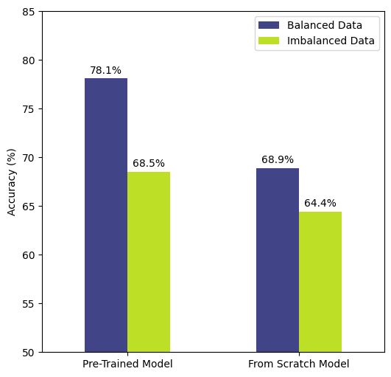
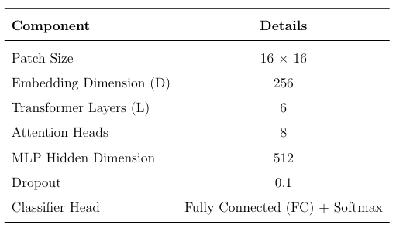
Experiment 3
Results
According to accuracy, the pre-trained model outperforms the train-from-scratch model in both imbalanced and balanced datasets.
Pre-Trained models are Best
Accuracy for Fine-Tuned and Model from Scratch on Balanced and Unbalanced Data
Model architecture of train from scratch model after tuning
Page
22

Slide 23
Experiment 4
Best Pre - Trained ViTs
Objective
Compare the performance of different pre-trained ViT models to identify the one that provides the best classification accuracy while maintaining optimal computational efficiency.
1
Generate images for each epoch using the GASF method with DWT downsampling to 128 Hz.
2
Apply up-sampling to create a balanced dataset.
3
Fine-tune the selected pre-trained ViT models using the balanced dataset.
4
Compare the performance of the fine-tuned pre-trained ViT models
Page
23

Slide 24
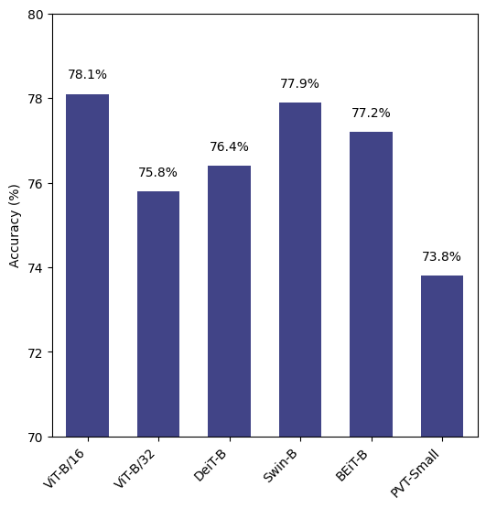
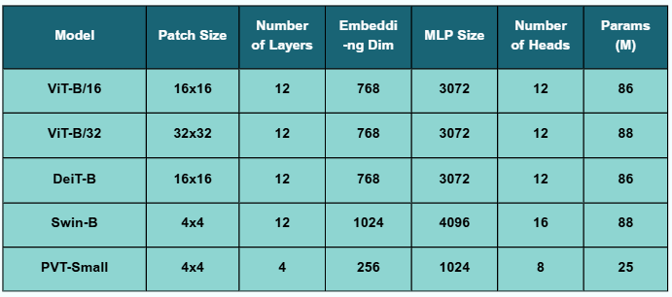
Experiment 4
Results
Model architectures of Pre-trained models
ViT-B/16 is the Best Model
Classification Accuracy of Pre-Trained Models
Page
24

Slide 25
Experiment 5
Tuning DCGAN for Synthetic Image Generation
Objective
Create a model to generate synthetic images using DCGAN to reduce subject-to-subject variability and class imbalances in sleep stage classification, ultimately enhancing dataset diversity and improving model generalization.
1
Generate images for each epoch using the GASF method with DWT downsampling to 128 Hz.
2
Split images into 70% for training and 30% for validation.
3
Train and optimize a DCGAN model for synthetic image generation.
4
Evaluate the quality of the generated images.
Page
25

Slide 26
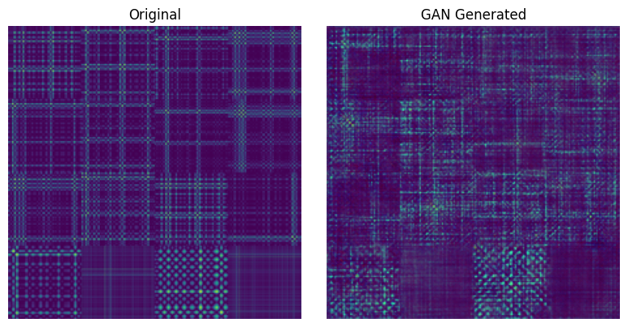
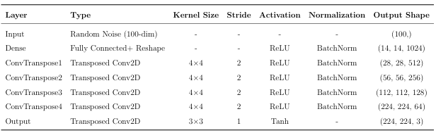
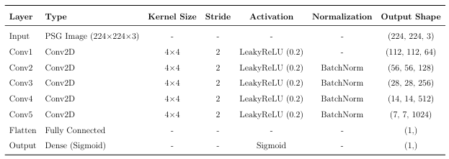
Experiment 5
Results
0.83
18.7
5.62
SSIM
FID
MPED
Results indicate that the synthetic images retain structural fidelity, exhibit reasonable realism, and maintain sufficient diversity, ensuring that synthetic samples enhance model generalization without redundancy.
Original Image vs. GAN Generated Synthetic Image
Model architecture of Generator in DCGAN
Model architecture of Discriminator in DCGAN
Page
26

Slide 27
Experiment 6
Effectiveness of GAN-Augmented Data
Objective
Evaluate the effectiveness of GAN-augmented data for sleep stage classification and determine whether synthetic data enhances accuracy and generalization.
1
Fine-tune the trained DCGAN model separately for each class.
2
Generate 20,000 synthetic images per class using encoder of the fine-tuned model for that class.
3
Create three datasets: original, GAN-augmented, and mixed.
4
Fine-tune the ViT-B/16 model on these datasets and evaluate its performance.
Page
27

Slide 28
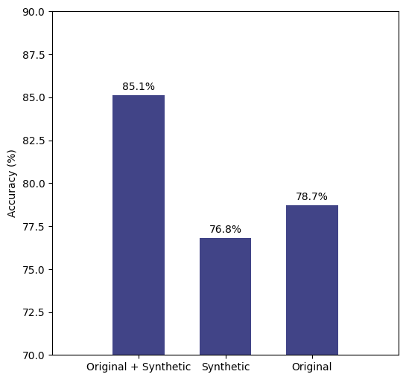
Experiment 6
Results
Original + Synthetic Data give highest performance
Impact of GAN-Augmented Data on Sleep Stage Classification Performance
Page
28

Slide 29
Final Model

Slide 30
Summary of Experiments
Exp 1
Evaluation of Image Transformation Techniques
GASF method achieved the best performance
Exp 2
Effect of Sampling Frequency and Resampling Method
DWT method with 128 Hz frequency achieved the best performance
Exp 3
Effectiveness of Pre-Trained vs. From Scratch ViTs
Pre-trained ViTs outperformed trained from scratch ViTs
Exp 4
Effectiveness of Different Pre-Trained ViTs
ViT-B/16 achieved the best performance
Exp 6
Effectiveness of GAN-Augmented Data
Mixed data (Original + Synthetic) achieved the best performance
Page
30

Slide 31
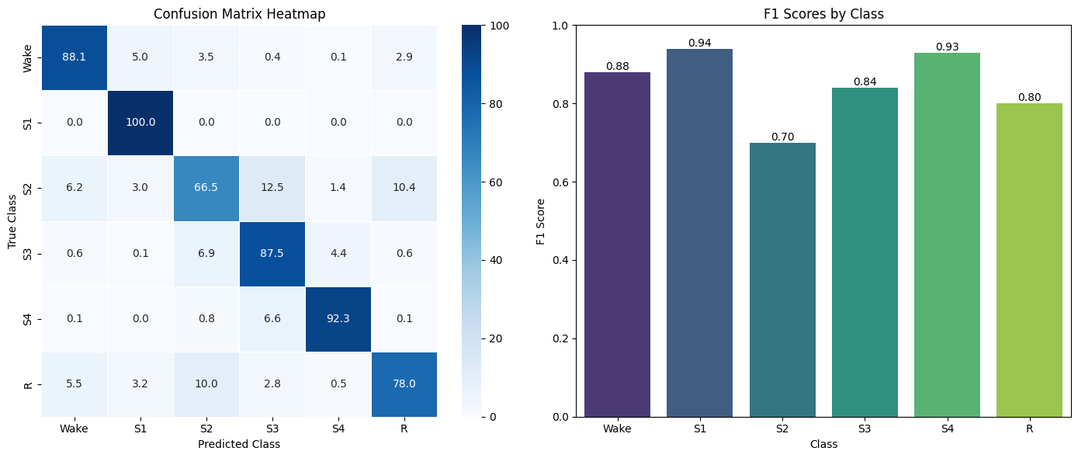
Final Model Results
Performance of the Final Model on Individual Sleep Stages
Overall Accuracy
84.8%
Page
31

Slide 32
Evaluation on Sleep Disorder Datasets
Data Set | Accuracy (%)
Healthy | 87.9
Insomnia | 92.8
Bruxism | 82.4
Narcolepsy | 88.2
NFLE | 86.6
PLM | 85.8
RBD | 81.0
SDB | 86.9
Page
32

Slide 33

Conclusions
1
ViT-B/16 with GASF + DWT at 128 Hz performed best for sleep stage classification.
2
Combining real and synthetic data improved accuracy, but synthetic-only data under performed.
3
DCGAN-based augmentation helped address class imbalance and variability.
Page
33

Slide 34

Limitations
1
The model generalizability to broader sleep conditions and populations remains uncertain.
2
GAN-generated data helped with class imbalance but was not reliable when used independently, requiring better GAN architectures.
3
Vision Transformers are resource-intensive, making real-time deployment in wearable devices challenging.
4
ViTs function as black boxes, making it difficult to understand their decision-making process; explainability techniques are needed.
Page
34

Slide 35

Further Work
1
Enhance synthetic data quality by using advanced GANs like StyleGAN or cGANs to reduce artifacts and blurring.
2
Evaluate the model on larger, more diverse datasets beyond used dataset to enhance generalization across populations and sleep conditions.
3
Evaluate the model on real-world sleep studies, including clinical datasets and long-term wearable device data, to assess practical applicability.
4
Explore hybrid models combining ViTs with CNNs or RNNs to improve performance, especially for sequential data.
5
Focus on model interpretability to enhance trust and understanding, especially for clinical applications.
Page
35

Slide 36
Thank You!

